Slide 1
StudyNotes – .NET Platform Reunification
Sudhansu Sekhar Sutar

Slide 2
Contents
Major .NET Stacks
.NET Portable Class Library (PCL)
.NET Reunification Plan
.NET Stack Comparison
.NET Standard Base Class Library
.NET Standard Versions
Microsoft Open Sourced Technology
.NET 5 A Unified Platform
Entity Framework Core (O/RM)
The Windows UI Library (WinUI)
.NET Multi-platform App UI (MAUI)
Evolution of .NET Tooling
Evolution of MS Development Technology
Year 2020 – Technology in Focus
References

Slide 3
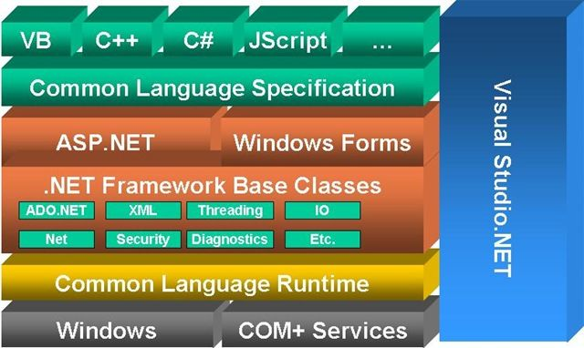
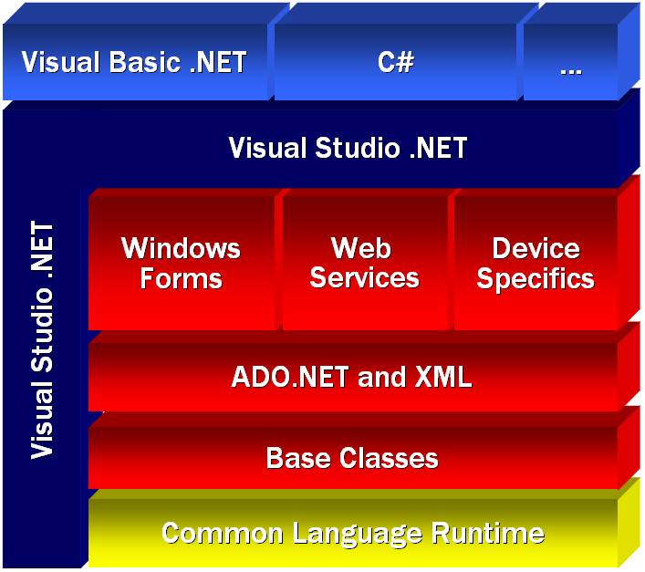
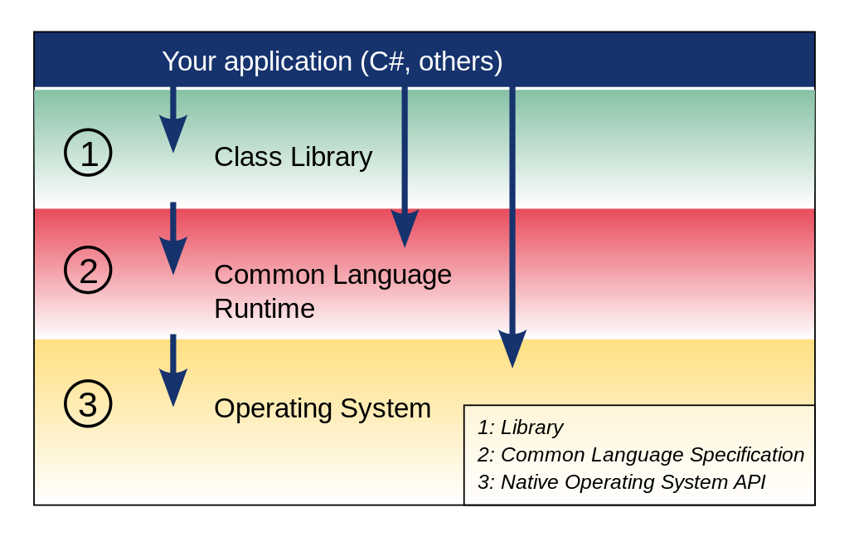
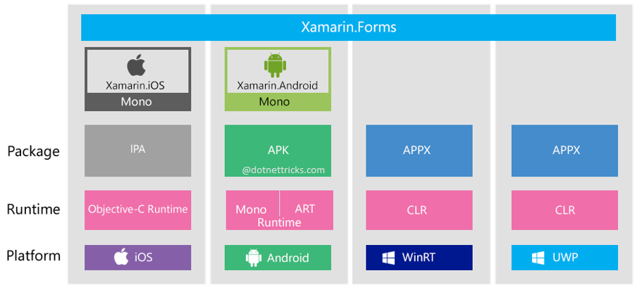
Major .NET Stacks
.NET Framework (Microsoft)
.NET Compact Framework (Microsoft)
Xamarin Platform (Xamarin)
Mono Project (Ximian, Inc.)

Slide 4
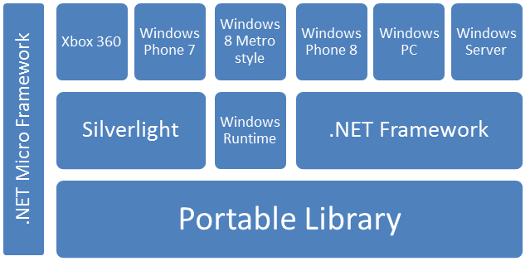
.NET Portable Class Library (PCL)
The Portable Class Library project enables to write and build managed assemblies that work on more than one Microsoft platforms such as Windows, Windows Phone etc.

Slide 5
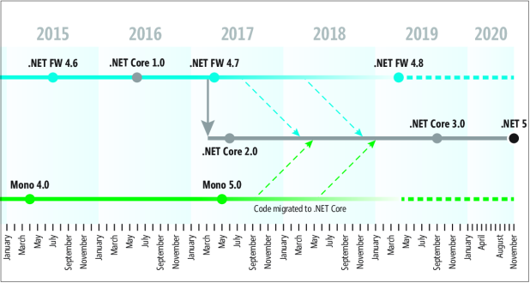
.NET Reunification Plan

Slide 6
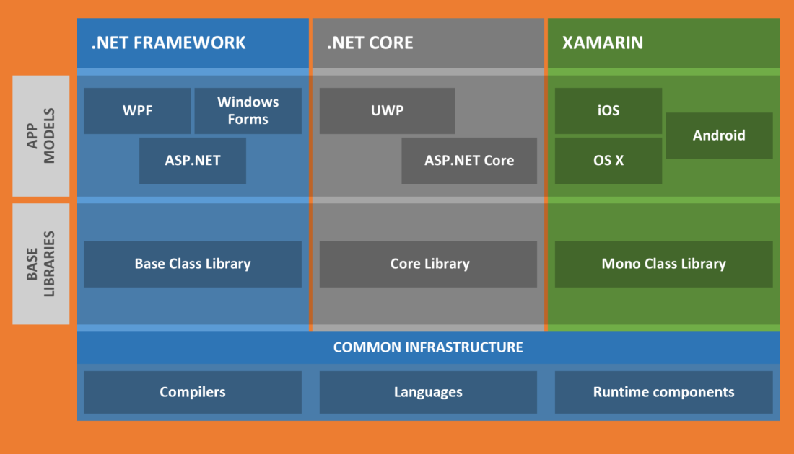
.NET Stack Comparison

Slide 7
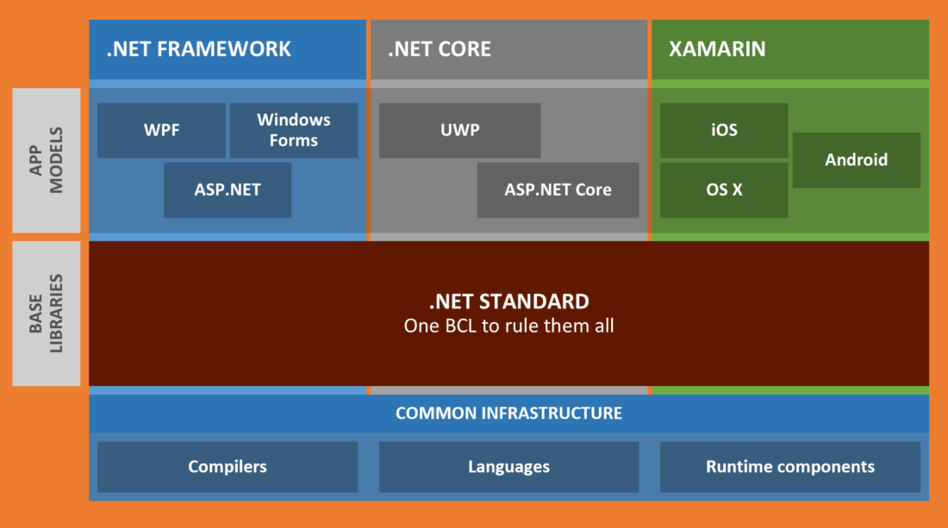
.NET Standard Base Class Library

Slide 8
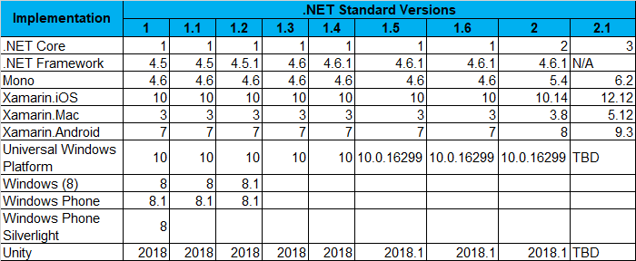
.NET Standard Versions

Slide 9
Microsoft Open Sourced Technology
Technology | Platform | Project Home
.Net Core | Windows, Linux, macOS | https://github.com/dotnet/core
WinForms Feb/2002 | Windows Desktop (.Net Fx 1.x) | https://github.com/dotnet/winforms
WPF Nov/2006 | Windows Desktop (.Net Fx 3.x) | https://github.com/dotnet/wpf
WinUI Nov/2012 | UWP (Desktop, Mobile, IoT) (.Net Fx 4.x, .Net Core Fx 3.x) | https://github.com/microsoft/microsoft-ui-xaml
MAUI May/2014 | Desktop & Mobile (Windows, Android, iOS) (.Net Core Fx 6.x) | https://github.com/dotnet/maui
EF Core | Windows, Linux, macOS | https://github.com/dotnet/efcore
ASP.Net Core | Windows, Linux, macOS | https://github.com/dotnet/aspnetcore

Slide 10
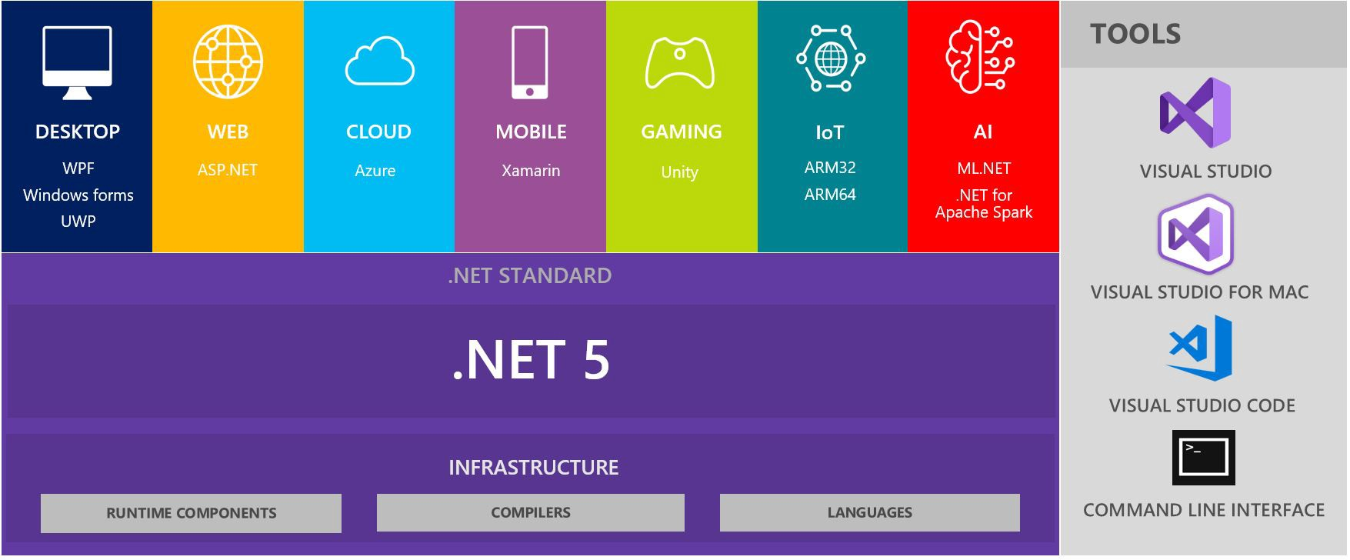
.NET 5 A Unified Platform

Slide 11
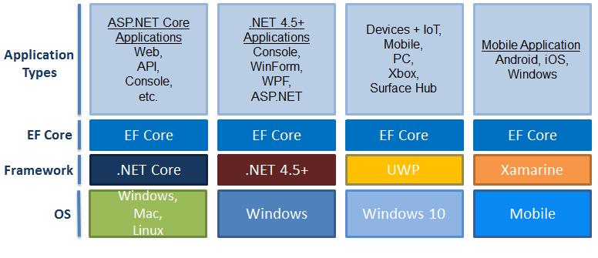
Entity Framework Core (O/RM)

Slide 12
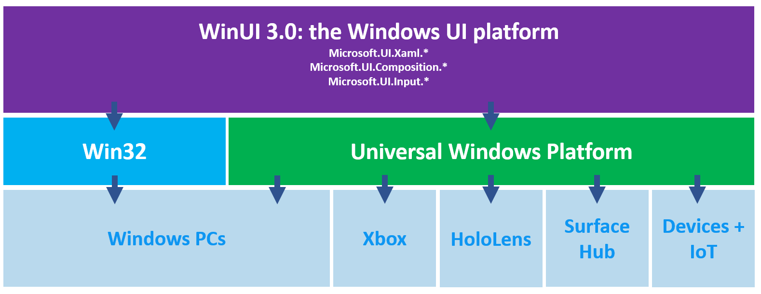
Modern Windows UI Library (WinUI)
Modern Windows UI Library decoupled from the UWP SDK. New App can be developed for both Win32 and UWP Platforms. It can also be used to gradually migrate existing MFC, WinForms, or WPF apps using familiar languages such as C++, C#, Visual Basic, and JavaScript.

Slide 13
.NET Multi-platform App UI (MAUI)
Multi-platform native UI
Deploy to multiple devices across mobile & desktop
Using a single project, single codebase
Evolution of Mono Xamarian.Forms
Targeting .NET 6 LST (Nov/2021).

Slide 14
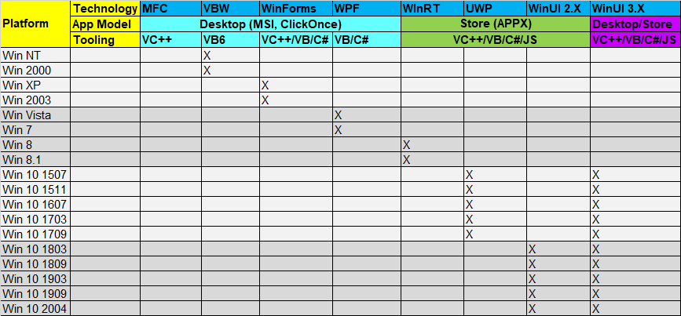
Evolution of MS Development Technology

Slide 15
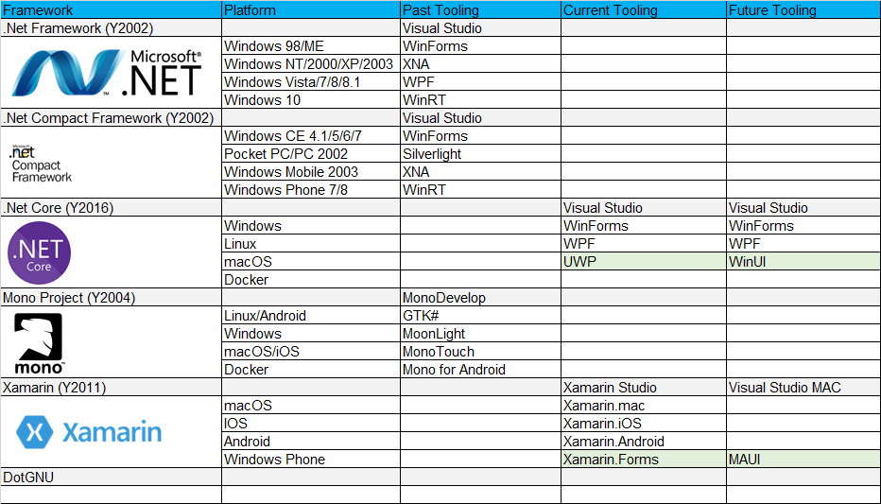
Microsoft Visual Studio .NET Tooling

Slide 16
Year 2020 – Technology in Focus
.NET 5
WinUI 3
AKS
WSL 2
Azure

Slide 17
References
https://docs.microsoft.com/en-us/archive/msdn-magazine/2019/july/csharp-net-reunified-microsoft%E2%80%99s-plans-for-net-5
https://medium.com/young-coder/the-reunification-of-net-5-5902744df9fe
https://docs.microsoft.com/en-us/windows/win32/appuistart/user-interface-technologies-for-windows-applications
https://docs.microsoft.com/en-us/windows/uwp/porting/android-ios-uwp-map

Slide 18
END OF FILE

